Slide 1

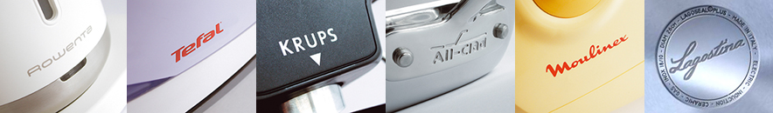
ALL-CLAD ARNO CALOR KRUPS LAGOSTINA
MOULINEX ROWENTA SEB SUPOR TEFAL
SEB INTERNATIONAL SERVICE January 2015

Slide 2
International
Repair
Information
System

Slide 3
Exchanging Repair Information
.…is facing several difficult problems.
  Different countries,
  Different languages,
  Different types of organization,
  Some different codes,
  …
So, there is a clear need to use an unified, simple codification system.
This code already exist: IRIS CODE.

Slide 4
IRIS Repair Coding
What is it?

Slide 5


IRIS Coding basis
The IRIS Code is divided in 4 chapters :
Symptom
Section
Defect
Repair
Consumer
Technician

Slide 6

Methodology to determine an IRIS code
Consumer :
The consumer describes the defect :
What ?
Example : « My steam generator cuts off the electrical circuit during the ironing »

Slide 7





Methodology to determine an IRIS code
Consumer : The description of the problem detected by the consumer is based on simple questions which he can answer.
The description depends of the 5 senses :
TO SMELL
TO SEE
TO HEAR
TO TOUCH
TO TASTE

Slide 8

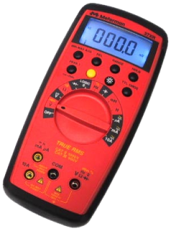
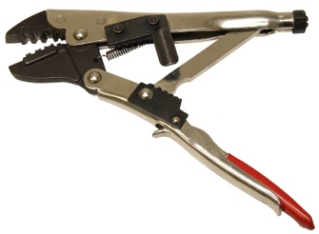
Methodology to determine an IRIS code
Technician :
The technician must :
Make an analysis, Make a diagnostic
and Bring a solution.
Example : « The boiler is faulty further to an electrical default and I change the part »

Slide 9
Methodology to determine an IRIS code
To transcribe these actions in an IRIS code.
WHAT ?  Symptom Code
MAKE AN ANALYSIS  Section Code
MAKE A DIAGNOSTIC  Defect Code
BRING A SOLUTION  Repair Code

Slide 10


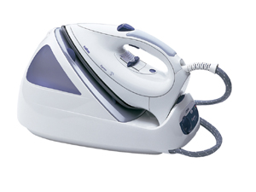
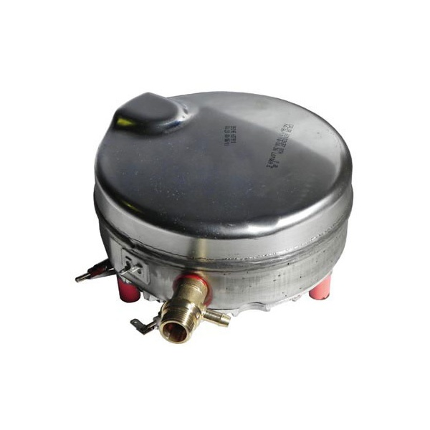


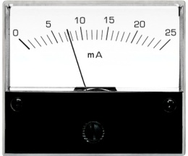

IRIS Code implementation  result
Technician :
What
Analysis and Diagnostic
Solution
> 5 mA
Replacement (component / module)
Internal switch / fuse in set triggers
Boiler
Leaking (electrical)
Symptom
11H
Section
G77
Defect
S
Repair
A

Slide 11
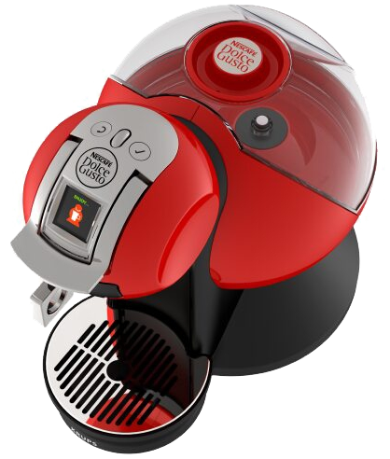
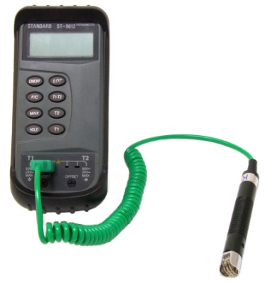
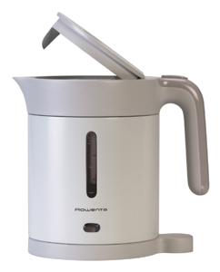
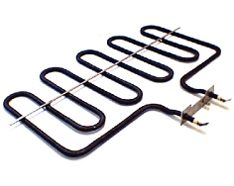
Code
YOUR GO

Slide 12
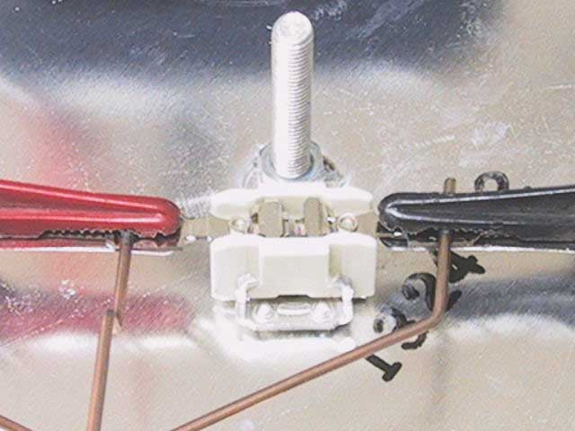

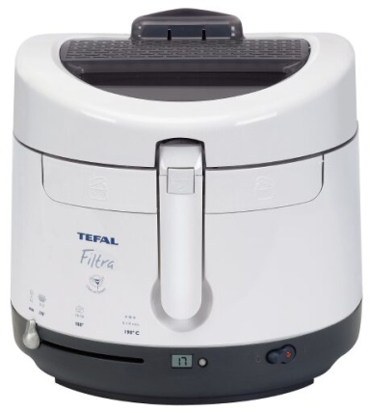
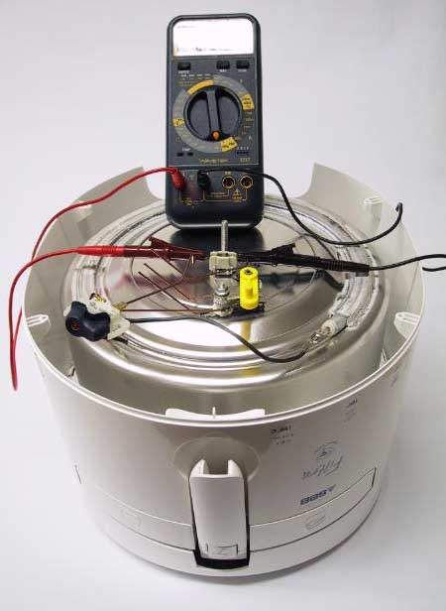
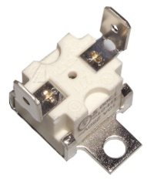
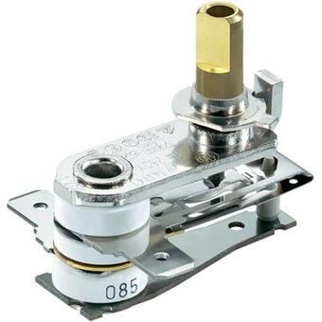
Consumer
Technician
1
Analysis and Diagnostic
Solution
Replace
My fryer does not work anymore
Symptom
11F
Section
G40
Defect
N
Repair
A

Slide 13
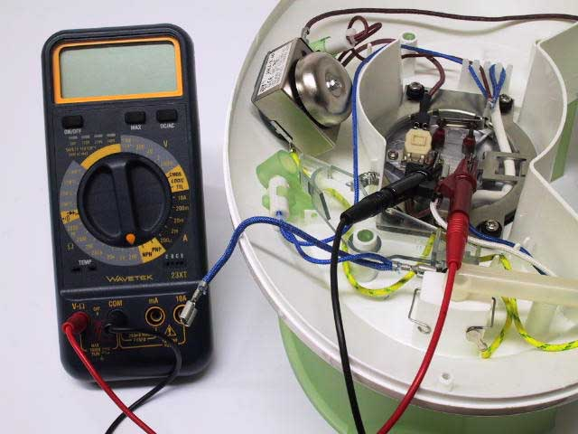
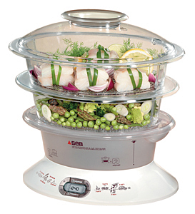
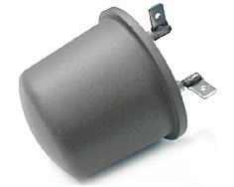
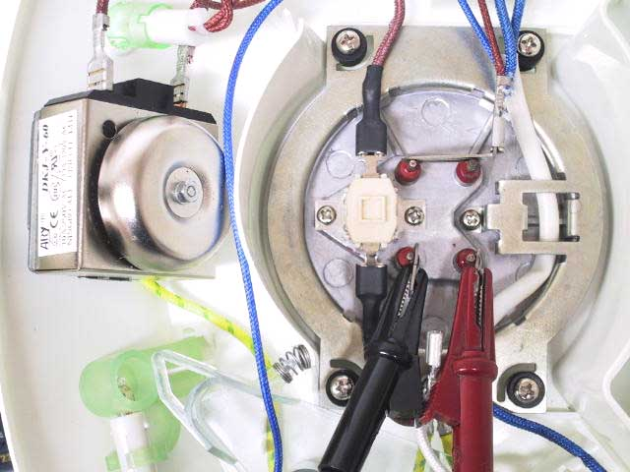
Consumer
Technician
2
Analysis and Diagnostic
Solution
--- Ω
Replace
My steamer does not work anymore
Symptom
11F
Section
G18
Defect
N
Repair
A

Slide 14
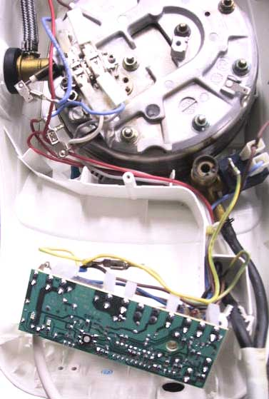
Consumer
Technician
3
Analysis and Diagnostic
Solution
Replace
My steam generator trips the circuit breaker my electrical installation
Symptom
11H
Section
G13
Defect
N
Repair
A

Slide 15
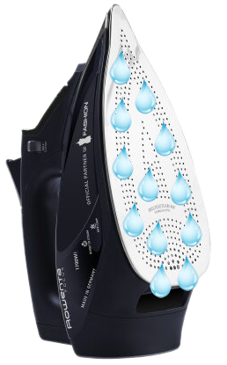
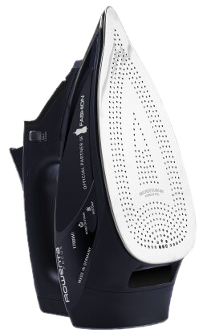
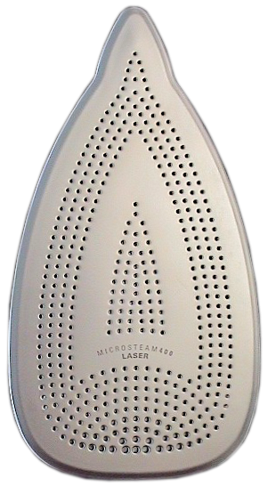
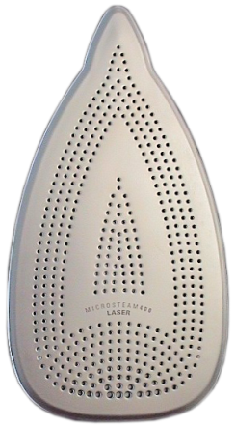
Consumer
Technician
4
Analysis and Diagnostic
Solution
Replace
The soleplate of my steam iron flowing water
The temperature of the soleplate is too low
Symptom
M32
Section
G40
Defect
P2
Repair
A

Slide 16
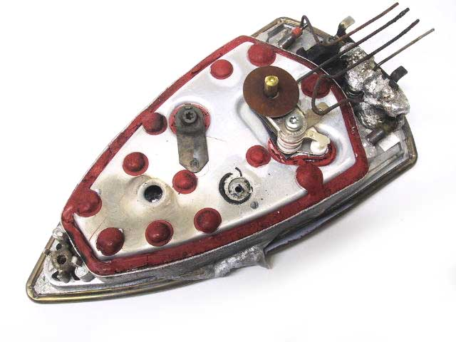
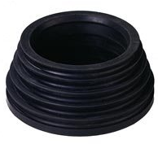

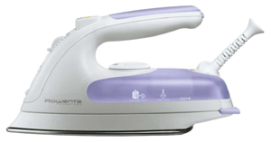


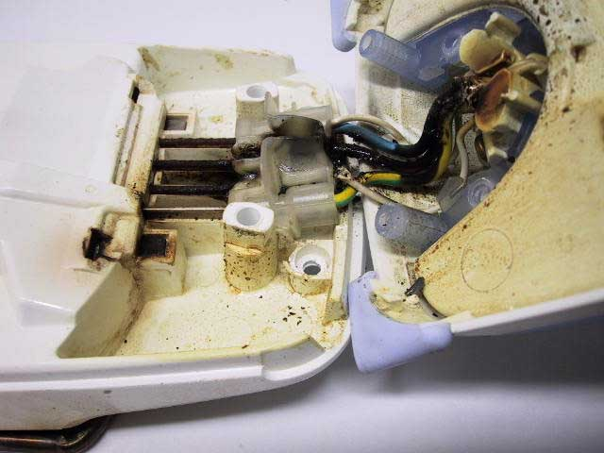

Consumer
Technician
5
Analysis and Diagnostic
Solution
Replace
Seal is cut
My steam iron does not work anymore
Other
spare parts
Symptom
11F
Section
G30
Defect
D
Repair
A

Slide 17
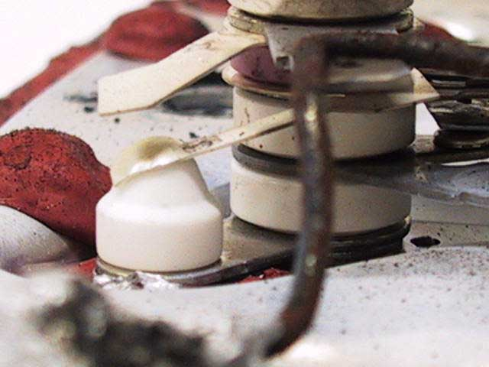
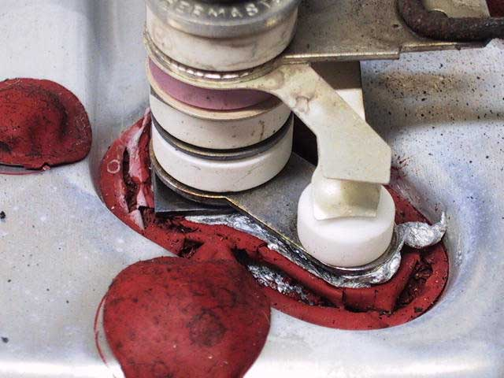
Consumer
Technician
6
Analysis and Diagnostic
Solution
Replace
My steam iron does not work anymore
Symptom
11F
Section
G40
Defect
Q
Repair
A

Slide 18
Consumer
Technician
7
Analysis and Diagnostic
Solution
Replace
My steam iron is not heating enough
The temperature of the soleplate is too low
Symptom
17S
Section
G40
Defect
C
Repair
A

Slide 19
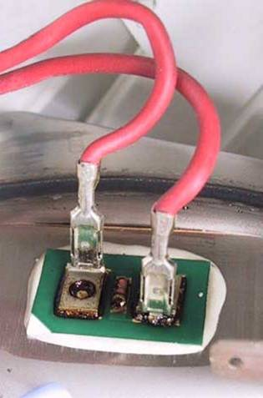

Consumer
Technician
8
Analysis and Diagnostic
Solution
Replace
----Ω
The indicator "Lack of water" of my steam generator lights all the time
Symptom
132
Section
G40
Defect
N
Repair
A

Slide 20
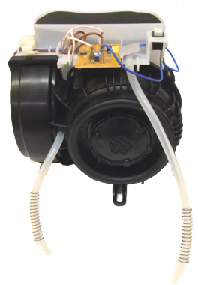
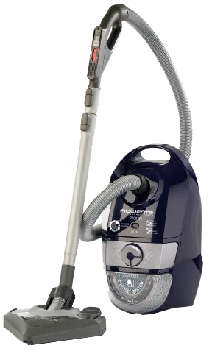
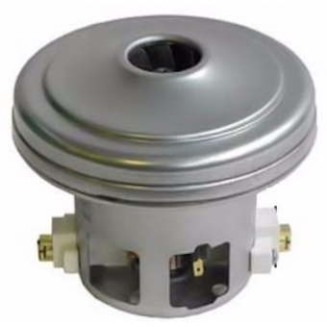

Consumer
Technician
9
Analysis and Diagnostic
Solution
Replace
My vacuum cleaner
doesn’t work
Symptom
11F
Section
G22
Defect
N
Repair
A

Slide 21
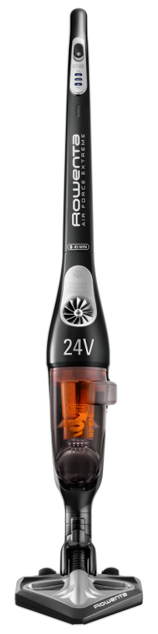

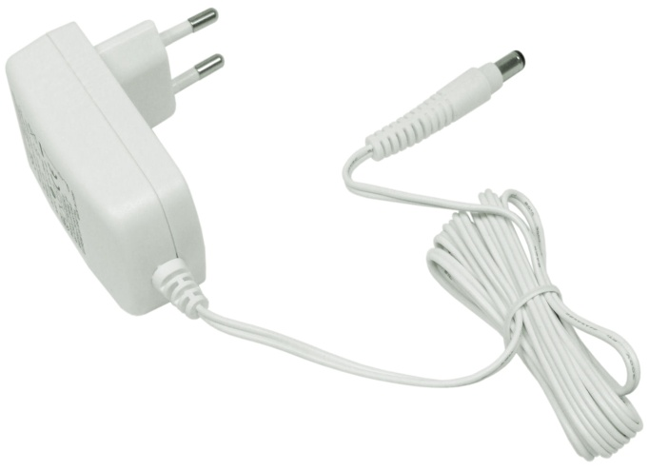
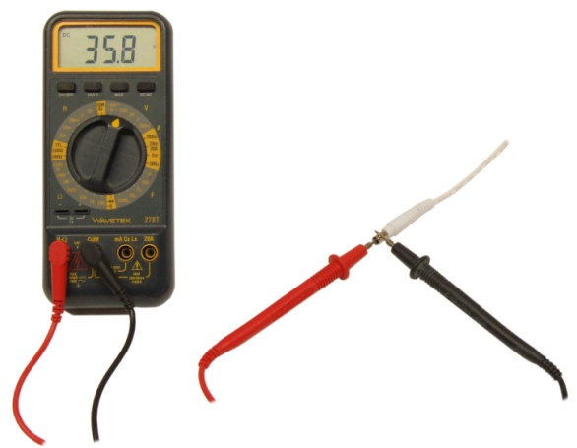

Consumer
Technician
10
Analysis and Diagnostic
Solution
Replace
> 40V dc
My vacuum cleaner will no longer charge and a light blinks steadily
Symptom
121
Section
G68
Defect
N
Repair
A

Slide 22

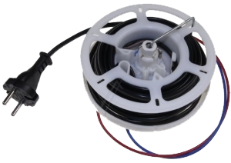
Consumer
Technician
11
Analysis and Diagnostic
Solution
Replace
The cord of my vacuum cleaner no longer fit into its housing
Symptom
17G
Section
G73
Defect
M1
Repair
A

Slide 23
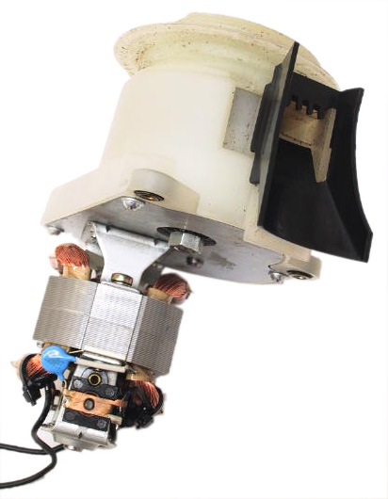
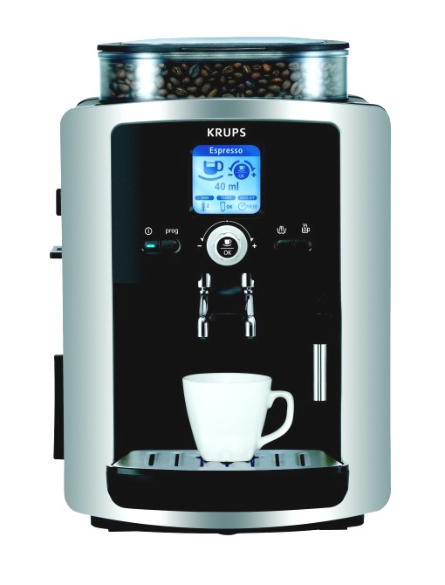
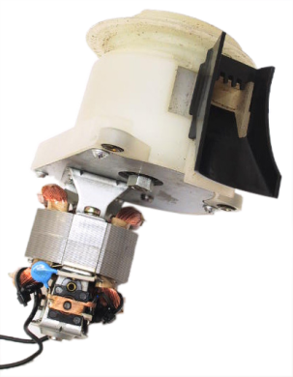
Consumer
Technician
13
Analysis and Diagnostic
Solution
Replace
My espresso no longer grinds coffee beans
Symptom
N13
Section
G22
Defect
N
Repair
A

Slide 24


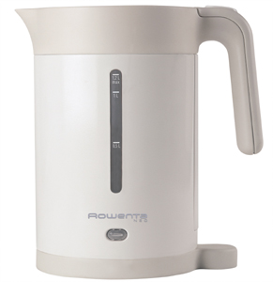

Consumer
Technician
14
Analysis and Diagnostic
Solution
Info about the functioning of the kettle to the consumer
My kettle never stops
Symptom
11F
Section
G61
Defect
4
Repair
U

Slide 25
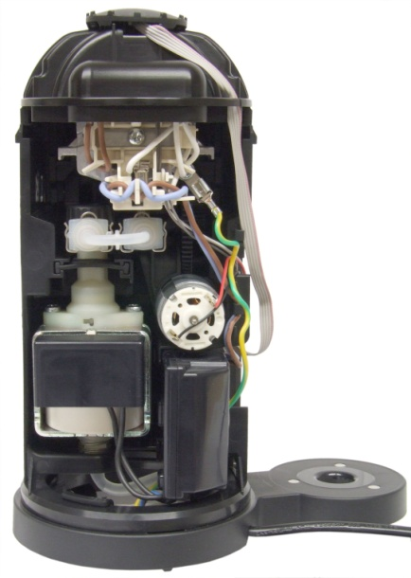
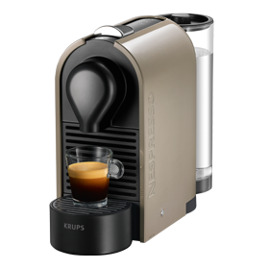
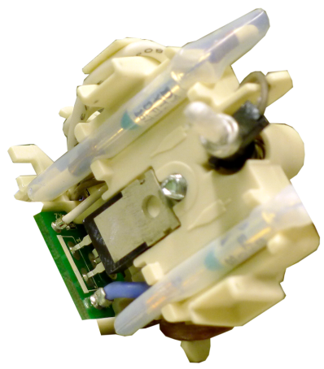
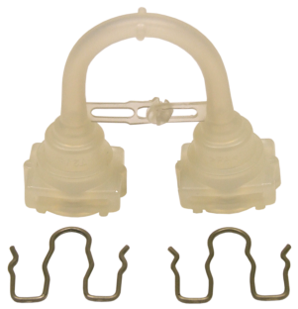
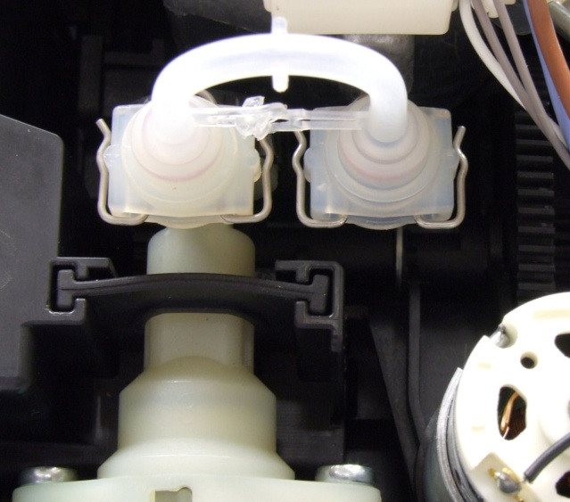
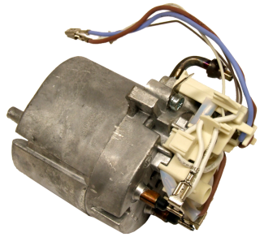


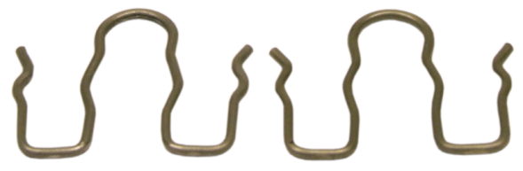
Consumer
Technician
16
Analysis and Diagnostic
Solution
Replace
My expresso maker does not work anymore
Symptom
11F
Section
G33
Defect
K
Repair
A

Slide 26
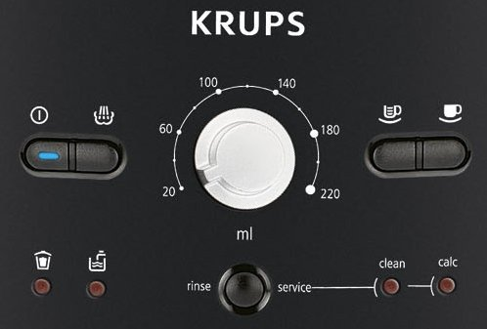



Consumer
Technician
18
Analysis and Diagnostic
Solution
Replace
My espresso does not start
Symptom
11F
Section
G02
Defect
D
Repair
A

Slide 27




Consumer
Technician
20
Analysis and Diagnostic
Solution
Replace
My mixer blade is no longer rotating
Symptom
J14
Section
G85
Defect
A
Repair
A

Slide 28


Consumer
Technician
21
Analysis and Diagnostic
Solution
Replace
The cover of my food processor is broken
Symptom
164
Section
G81
Defect
H1
Repair
A

Slide 29




Consumer
Technician
22
Analysis and Diagnostic
Solution
Replace
The bowl of my blender leaks
Symptom
J52
Section
G30
Defect
K
Repair
A

Slide 30
DEMONSTRATION
http://www.iriscode.org/

